Slide 1




JavaScript for Front-End
Course Overview
JavaScript
SoftUni Team
Technical Trainers
Software University
http://softuni.bg

Slide 2




Table of Contents

Slide 3
Have a Question?
sli.do #front-end

Slide 4







SoftUni Diamond Partners

Slide 5



JavaScript for Front-End
Course Objectives & Program

Slide 6
JavaScript – Course Topics
Introduction to Bootstrap – What is Bootstrap. Bootstrap Components. Bootstrap Grid System.
CSS Preprocessors (SASS, LESS) – SASS and LESS Overview. Nesting, Variables, Mixins, Selector Inheritance
Introduction to JavaScript – Basic Syntax, Arrays, Functions, Objects, JSON
Introduction to JQuery & DOM – JQuery, Selectors, DOM Manipulation, Events…
JS Libraries – Libraries for Notifications, Stickies, Sliders etc.

Slide 7


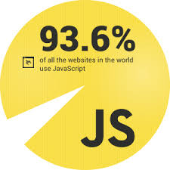
JavaScript – Course Topics (2)
Introduction to AJAX – JQuery Ajax Concept, Requests, HTTP
Exam Preparation
Practical Exam

Slide 8

The Trainers Team

Slide 9

Trainers Team
Ivaylo Dimitrov
4+ years experience in the IT (HTML, CSS, JavaScript, C#, SQL,
Windows Server)
Student with excellent grades in Software University
Technical Trainer in Software University

Slide 10

JavaScript for Front-End: More Details
Duration, Languages, Technologies

Slide 11


Training Duration – JavaScript for Front-End
Lessons: ~ 35 hours (onsite + YouTube videos)
Practical exercises (in class): ~ 40 hours
Homework: ~ 30 hours
Exam preparation: 8 hours
Exam: 6 hours
Schedule: 8 March – 15 April 2018
Exam date: 15 April 2018

Slide 12



Why English?
Why the slides are in English?
English is the native language of the software engineers
Specific terminology should be in English
Translations are inaccurate and funny
Just learn English!
No excuses

Slide 13



Learn to Search in Internet & Find Solutions!
The course assignments require to search in Internet
This is an important part of the learning process
Some exercises intentionally have no hints
Learn to find solutions!
Software development includes everyday searching and learning
No excuses, just learn to study!
Developers learn new technologies, tools, languages every day!

Slide 14

Evaluation

Slide 15


Scoring System for the Course
Mandatory:
Final exam – 90%
Homework submissions – 10%
Bonuses:
Presence in class – 5% bonus
Forum activity – bonus up to 5%

Slide 16
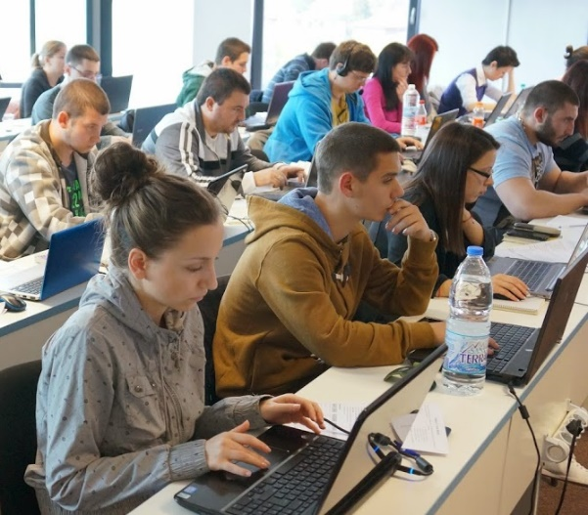

JavaScript for Front-End Exam
Practical JavaScript application exam
4 problems for 6 hours
Simple website
Simple algorithmic problem
JQuery manipulations(DOM, etc…)
AXAJ

Slide 17

Homework Assignments
Doing your homework is very important!
HTML and CSS can only be learned through a lot of practice!
You should write code every day!
Each lesson is followed by a few exercises
Try to solve them in class
The rest are your homework
Homework assignments are due in 6 days after each lesson

Slide 18










Resources
What We Need Additionally?

Slide 19



JavaScript Course Web Site, Forum and FB Group
Official web site:
Official discussion forum:
Official Facebook groups:
https://softuni.bg/courses/javascript-for-front-end
https://softuni.bg/forum/categories/68/web-basics
https://www.facebook.com/groups/SoftwareUniversityJavaScriptForFrontEndMarch2018

Slide 20

The Front-End Development Slides and Videos
All lecture slides, videos, homework assignments, projects and other resources are open content, available for free
Visit the course web site to access the course resources

Slide 21

Software University Learning System (SULS)
Software University Learning System (SULS)
www.softuni.bg
Important resource for students
Homework submissions
Homework check-up
Exams and results
Reports about your progress
…

Slide 22





Recommended Software
You will need a good IDE like:
WebStorm
Visual Studio Code
Brackets
Microsoft Visual Studio

Slide 23


Summary
The “JavaScript for Front-End" course teaches
The first steps in JavaScript
Training curriculum
Basic Syntax, JSON, Objects, Libraries etc.
Practical exam
4 problems for 6 hours
Learning resources
Slides, videos, software, books, forum

Slide 24
JavaScript for Front-End – Course Overview
https://softuni.bg/courses/javascript-for-front-end

Slide 25
License
This course (slides, examples, demos, videos, homework, etc.) is licensed under the "Creative Commons Attribution-NonCommercial-ShareAlike 4.0 International" license

Slide 26





Trainings @ Software University (SoftUni)
Software University – High-Quality Education, Profession and Job for Software Developers
softuni.bg
Software University Foundation
http://softuni.foundation/
Software University @ Facebook
facebook.com/SoftwareUniversity
Software University Forums
forum.softuni.bg

